Slide 1
SS ZG653: Software Architecture Lecture 10: Mud-to-Structure
Instructor: Prof. Santonu Sarkar
February 23, 2015

Slide 2
Pipes & filters
Mud to Structure

Slide 3
Pipes and Filters
A structure for systems that process a stream of data
Filter
Has interfaces from which a set of inputs can flow in and a set of outputs can flow out
processing step is encapsulated in a filter component
Independent entities
Does not share state with other filters.
Does not know the identity to upstream and downstream filters
All data does not need to be processed for next filter to start working
Pipes
Data is passed through pipes between adjacent filters
Stateless data stream
Source end feeds filter input and sink receives output.
Recombining filters allows you to build families of related systems

Slide 4
Pipes and Filters – 3 part schema
Context | Processing Data Streams
Problem | System that must process or transform a stream of input data. Multi-stage operations on data (workflow) Many developers may work on different stages Requirements may change
Forces | Future enhancements – exchange processing steps or recombination Reuse desired, hence small processing steps Non adjacent processing steps do not share information Different sources of data exist (different sensor data) Store final result in various ways Explicit storage of intermediate results should be automatically done Multiprocessing the steps should be possible
Solution | Pipes and filters – data source to data sink

Slide 5
Simple case
Filter-1
Filter-2
Data Sink
Data Source
Pipe-1
Pipe-2
Pipe-3
ls scores| grep -e July | sort
Data source – file containing scores
Filters
Listing of scores
Filtering only July scores
Sorting of records

Slide 6
Known Example –Compiler Design
Source File
Lexical analyzer
Parser
Semantic Analyzer
Code Generator
Optimizer
Token string
Abstract syntax tree
Augmented AST
Object code
Object File

Slide 7
Various Components
Data Source
Represents input to the system
Sequence of data of the same structure or type
collects results from end of the pipeline
Active: pulls results from preceding processing stage
Passive: allows preceding filter to push or write the results into it
Filters are processing units
Enriches – computing and adding information
Refine – concentrating or extracting information
Transforms – delivering data in some other representation
Data Sink

Slide 8
Scenario-1
Push pipeline [Activity starts with the Data source]
Filter activity started by writing data to the filters
Passive Filter [Use direct calls to the adjacent pipeline]

Slide 9
Scenario-2
Pull pipeline
Control flow is started by the data sink calling for data

Slide 10
Scenario 3
Push-pull mixed pipeline

Slide 11
Scenario 4- Multiprocess
All filters actively pull, compute and push data in a loop
Each filter runs its own thread of control
Filters are synchronized by buffering pipe between them

Slide 12
Implementation
# | Steps
1 | Divide the system’s task into a sequence of processing stages
2 | Define the data format to be passed along each pipe
3 | Decide how to implement each pipe connection
4 | Design and implement the filters
5 | Design the error handling
6 | Set up the processing pipeline

Slide 13
Initial Steps
1: Divide the systems tasks into sequence of processing stages
2: Define data format to be passed along each pipe
Each stage must depend on the output of the predecessor
All stages conceptually connected by data flow
Define a uniform format results in the highest flexibility because it makes recombination of filters easy
Define the end of input marking

Slide 14
Design Pipe and Filter
3. Pipe
4. Filter
Decision determines active or passive filter
Using a separate pipe mechanism that synchronises adjacent active filters provide a more flexible solution
Design Depends on
Task it must perform
Adjacent pipe
Active or Passive filters
Active filter pulls data from a pipe
Passive ones get the data
Implemented as threads or processes
Filter reuse
Each filter should do one thing well
Can read from global or external files for flexible configuration

Slide 15
Final Steps
5: Design error handling
6: Setup processing pipeline
Never neglect error handling
No global state shared; error handling hard to address
Strategies in case of error – depend on domain
Use of standardised main program
Use of user inputs or choice

Slide 16
Variants
Tee and Join pipeline
Filters with more then one input and/or more than one output

Slide 17
Benefits
No intermediate files necessary, but possible
Filter addition, replacement, and reuse
Possible to hook any two filters together
Rapid prototyping of pipelines
Concurrent execution
Certain analyses possible
Throughput, latency, deadlock

Slide 18
Liabilities
Sharing state information is expensive or inflexible
Data transformation overhead
Error handling can be a problem
Does not work well with interactive applications
Lowest common denominator on data transmission determines the overall throughput

Slide 19
Blackboard Architecture Pattern
Mud to Structure

Slide 20
Context and Problem
A set of heterogeneous specialized modules which dynamically change their strategies as a response to unpredictable events
Non-deterministic strategies
Problem
When there is no deterministic solutions to process raw data, and it is required to interchange algorithms processing some intermediate computation
Solutions to partial problems require different representation
No predetermined strategy is present to solve a problem (in functional decomposition sequence of activations are more hard-coded)
Dealing with uncertain knowledge

Slide 21
Forces
A complete search of the solution space is not possible
Different algorithms to be used for partial solutions
One algorithm uses results of another algorithm
Input, intermediate data, output can have different representation
No strict sequence between algorithms, one can run them concurrently if required

Slide 22
Examples
Speech recognition (HEARSAY project 1980)
Vehicle identification and tracking
Robot control (navigation, environment learning, reasoning, destination route planning)
Modern machine learning algorithms for complex task (Jeopardy challenge)
Adobe OCR text recognition
Modern compilers tend to be more Blackboard oriented

Slide 23
Blackboard Pattern
Two kinds of components
Central data structure — blackboard
Components operating on the blackboard
System control is entirely driven by the blackboard state

Slide 24
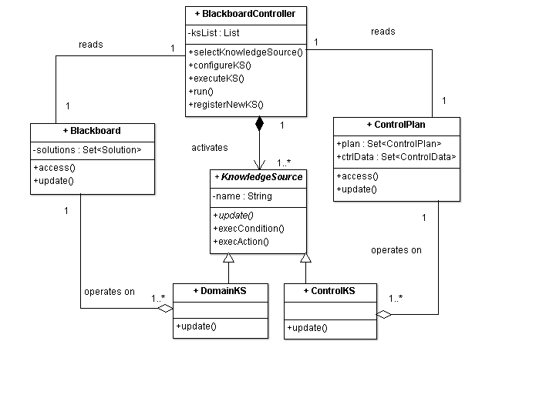
Solution Structure
Runs in a loop
Monitors change in blackboard
Activates next KS
Selection strategy may depend on ControlData
Highly specialized modules
Each is different
Has a set of triggering conditions
Executable code that retrieves data from the blackboard and updates blackboard
Don’t interact with each other
Updates control Data
Such as:
progress estimation,
computation cost to execute a KS
Control plan
Shared datastore containing partial solutions

Slide 25
Benefits
Benefits
Liabilities
Experimentation- try with different strategies,
Support for modifiability- each KS is strictly decoupled
Reuse of KS
Fault-tolerance even when the data is noisy
Difficulty in testing
No good solution guaranteed
Computational overhead in rejecting wrong solutions
High development effort
Concurrent access to blackboard must be synchronized, parallelization is difficult

Slide 26
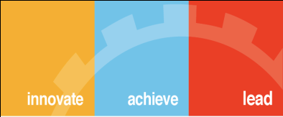
Thank You

